Slide 1
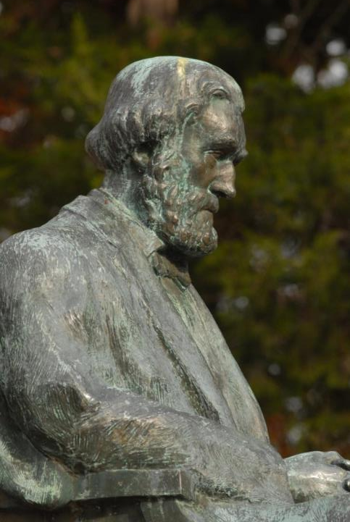
C
Penn Center: A History Preserved
Vernon Burton, Creativity Chair of Humanities
Director, Clemson CyberInstitute
Professor of History & Sociology
Professor of Human-Centered Computing in the School of Computing
Emeritus University of Illinois

Slide 2
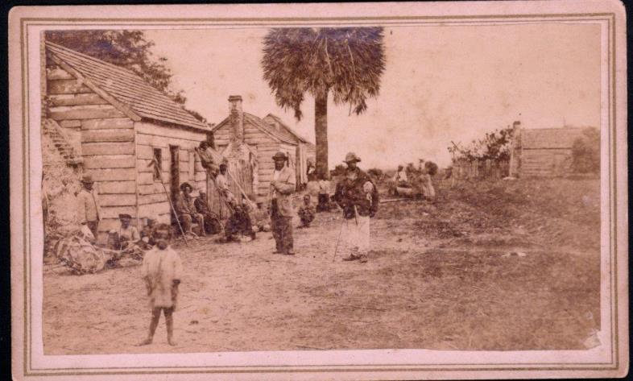
Cabins for Enslaved Workers
Notes:
Cabins for enslaved workers

Slide 3
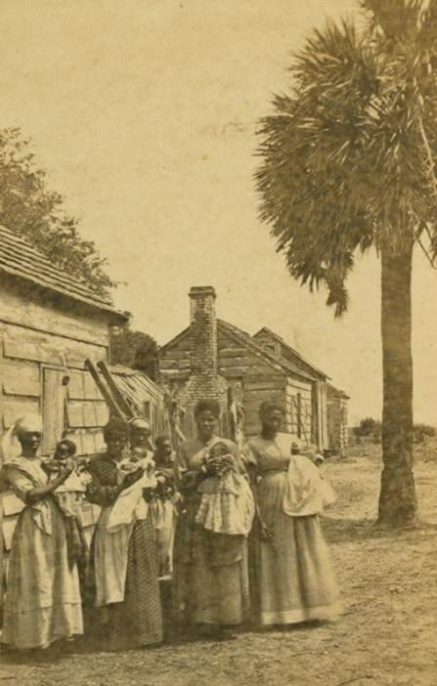
Notes:
mothers

Slide 4
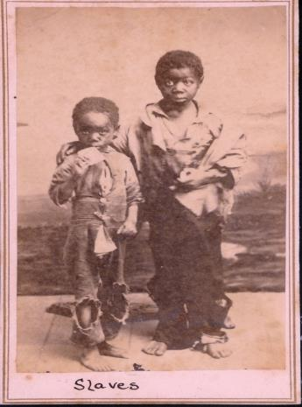
Enslaved Children
Notes:
Enslaved children

Slide 5
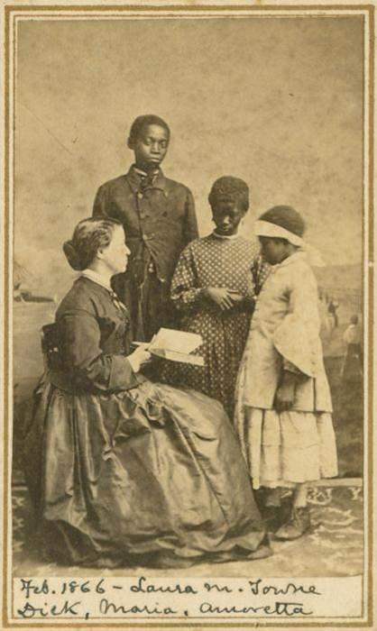
Laura Towne with Students
Notes:
Laura Towne with students

Slide 6
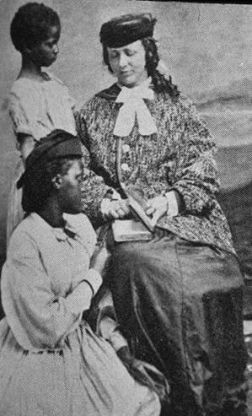
Ellen Murray with Students
Notes:
Ellen Murray with students

Slide 7
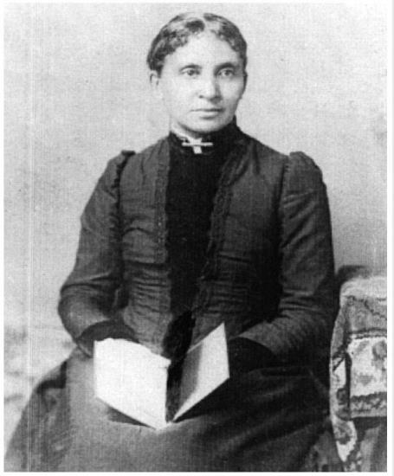
Charlotte Forten 1862 LOC
Notes:
Charlotte Forten 1862 Photograph Library of Congress

Slide 8
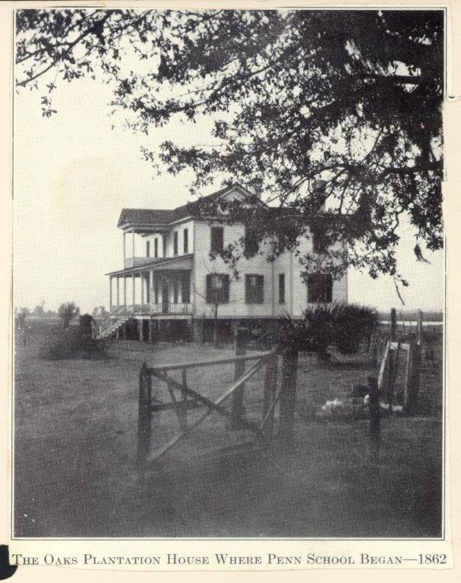
Notes:
Oakes Plantation House where Penn School Began 1862

Slide 9
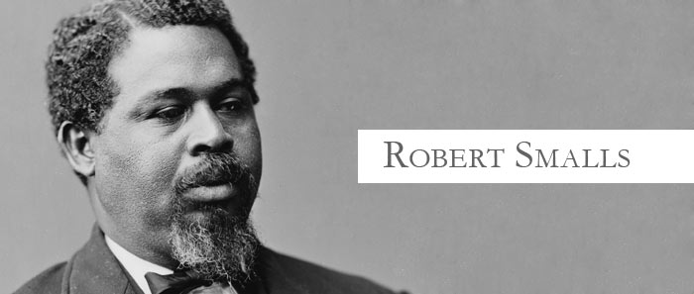
1839-1915
(Beaufort)

Slide 10
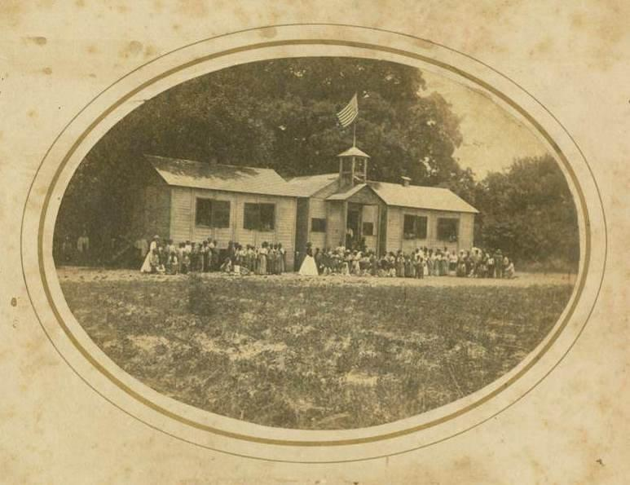
Penn School House with Students
Notes:
Penn School building

Slide 11
Rossa Cooley and Grace House in Hampton House, 1918

Slide 12
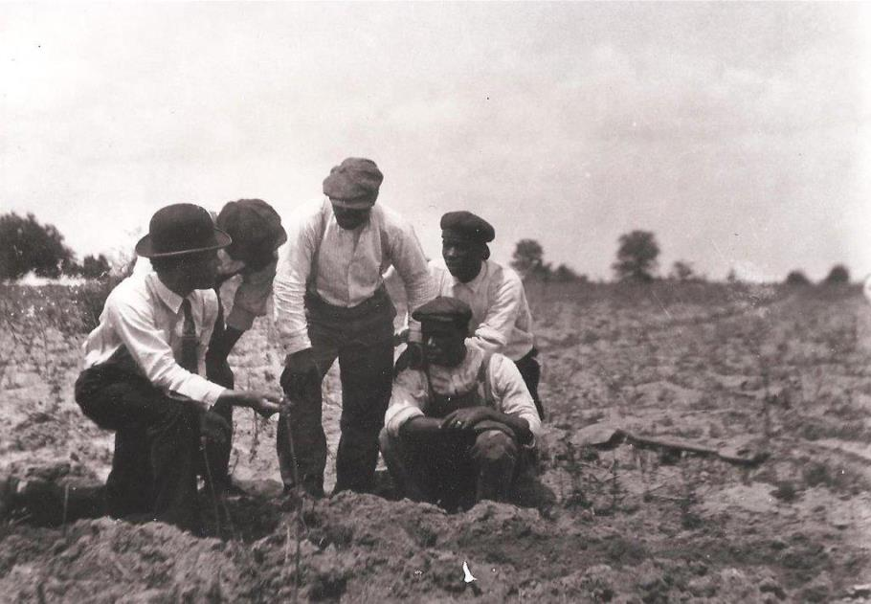
Notes:
5 students in a field at Penn School

Slide 13
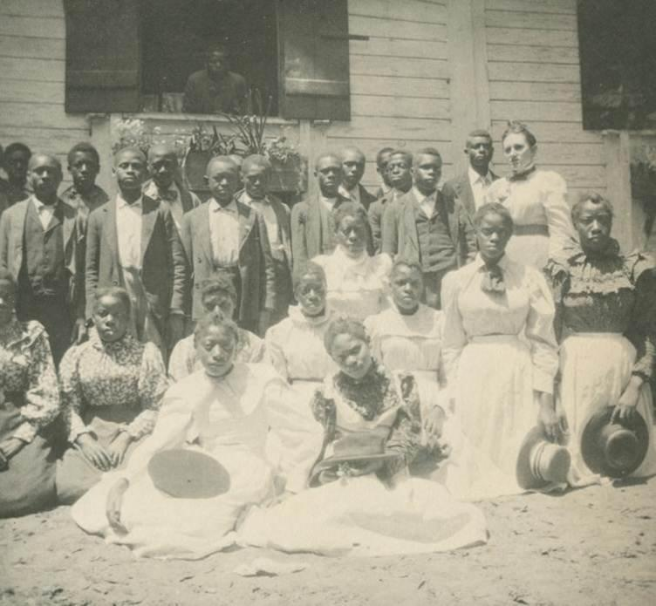
Notes:
Group Photo early 1900s

Slide 14
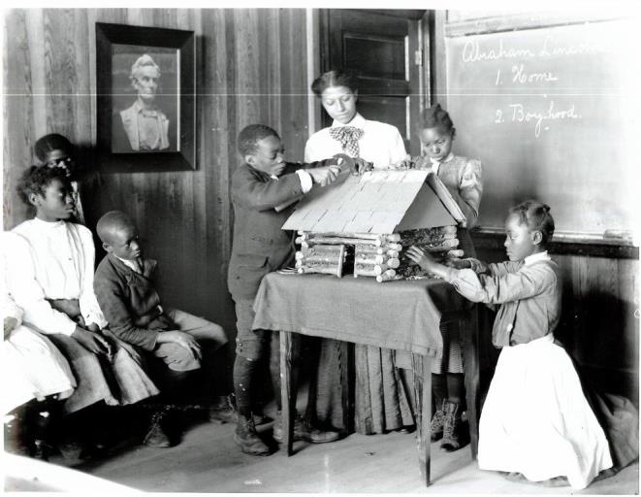
Notes:
The Lincoln Lesson

Slide 15
Miss Massey with Grade 1
Notes:
Miss Massey with Grade 1

Slide 16
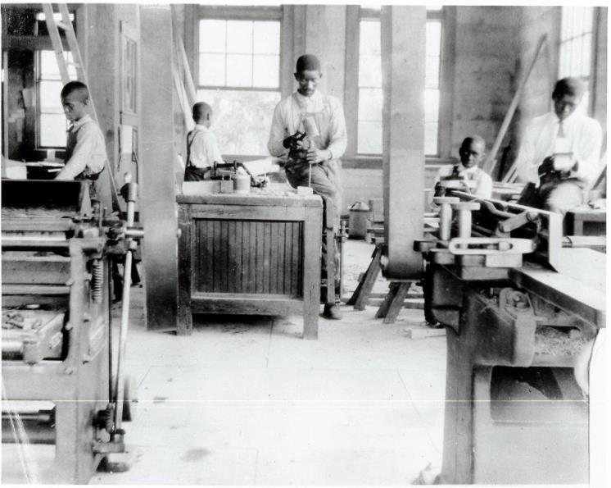
Woodworking Class
Notes:
Woodworking class

Slide 17
Male Students at Penn Center

Slide 18
Working Male at Cope Shop, April 1913, Industrial Arts Class

Slide 19
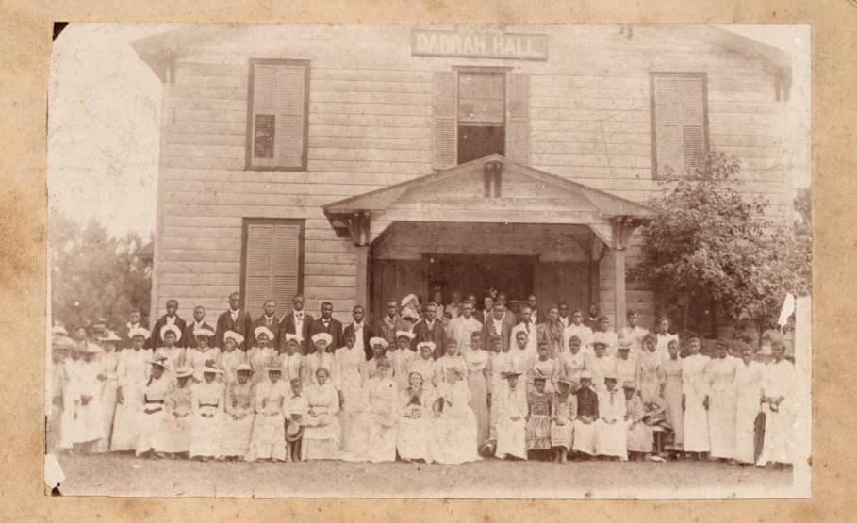
Midwives Graduating from Penn
Notes:
Midwives graduating from Penn School

Slide 20
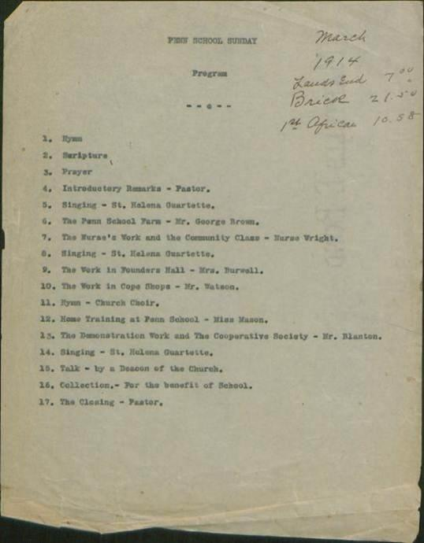
1914 program
Notes:
1914 program

Slide 21
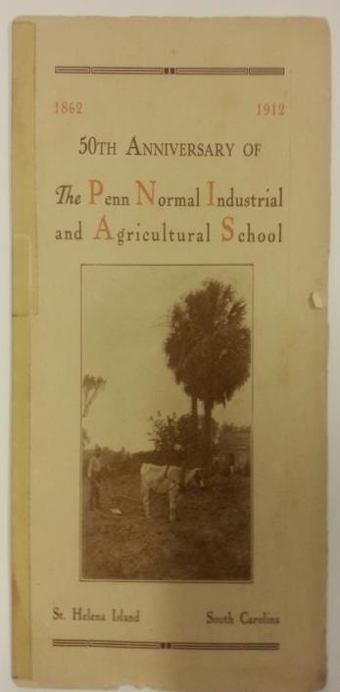

Slide 22
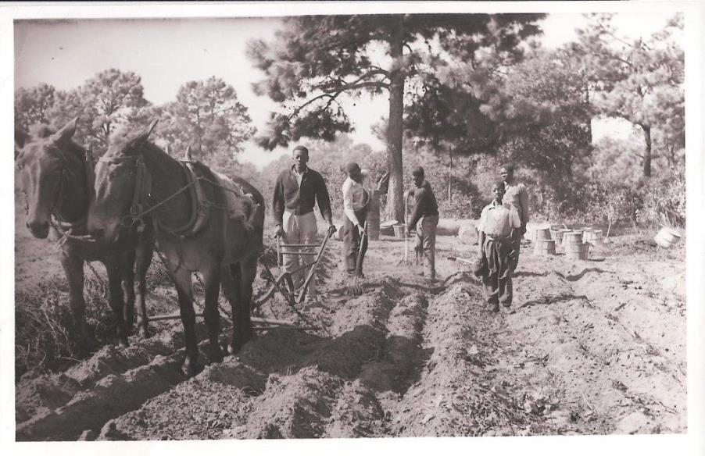
Elting Smalls plowing with two mules
Notes:
Penn Student Elting Smalls, Plowing with two mules

Slide 23
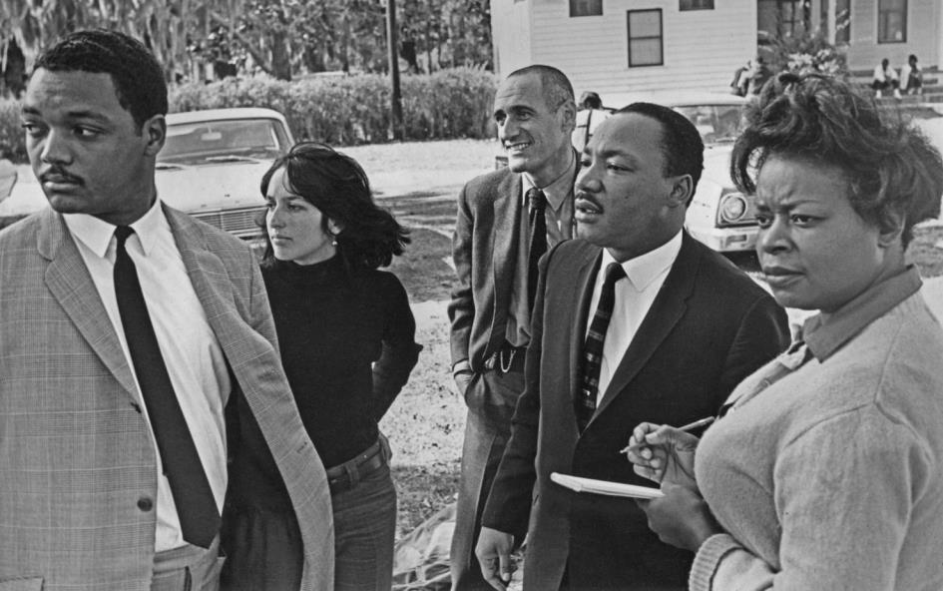
Jesse Jackson, Joan Baez, Ira Sanperl, MLK, Dora McDonald
Notes:
Jesse Jackson, Joan Baez, Ira Sandperl, Martin Luther King, Jr., Dora McDonald at Penn

Slide 24
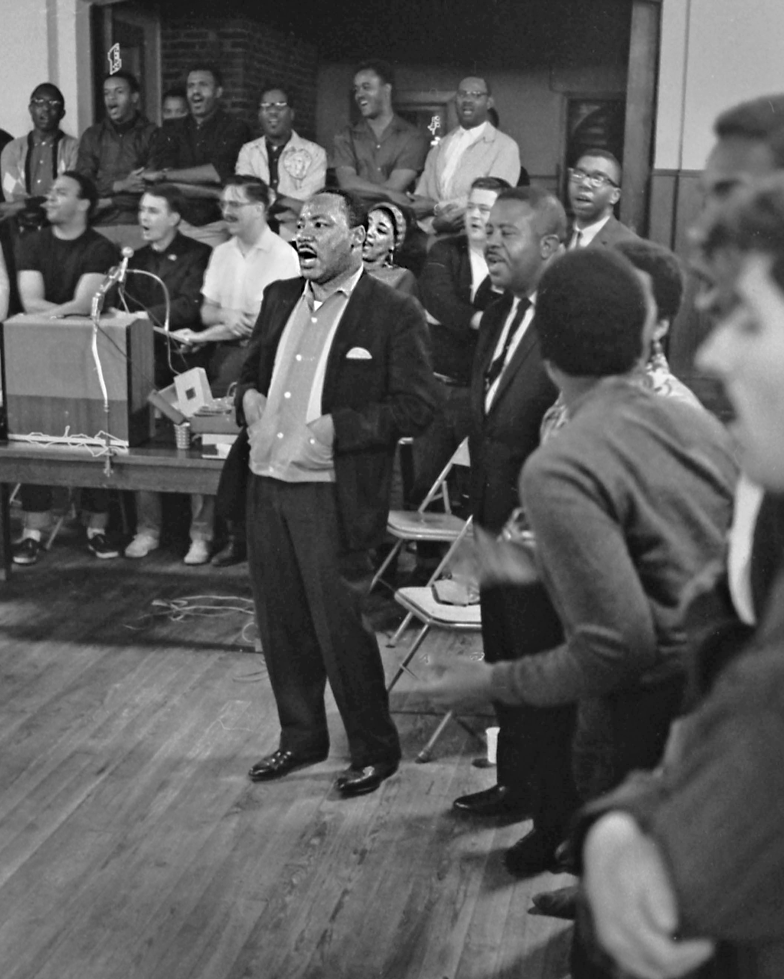
Notes:
Martin Luther King singing

Slide 25
James Lawson
Notes:
James Lawson leading a workshop at Penn Center with Ira Sandperl

Slide 26
Hosea Williams –King in background
Notes:
Hosea Williams at group singing (King in background)

Slide 27
Andrew Young
Notes:
Andrew Young at workshop

Slide 28
Joan Baez and King
Notes:
Joan Baez

Slide 29
King and Fred Shuttleworth sing “we shall overcome”
Notes:
King, Fred Shuttlesworth, and others singing “We shall overcome.”

Slide 30
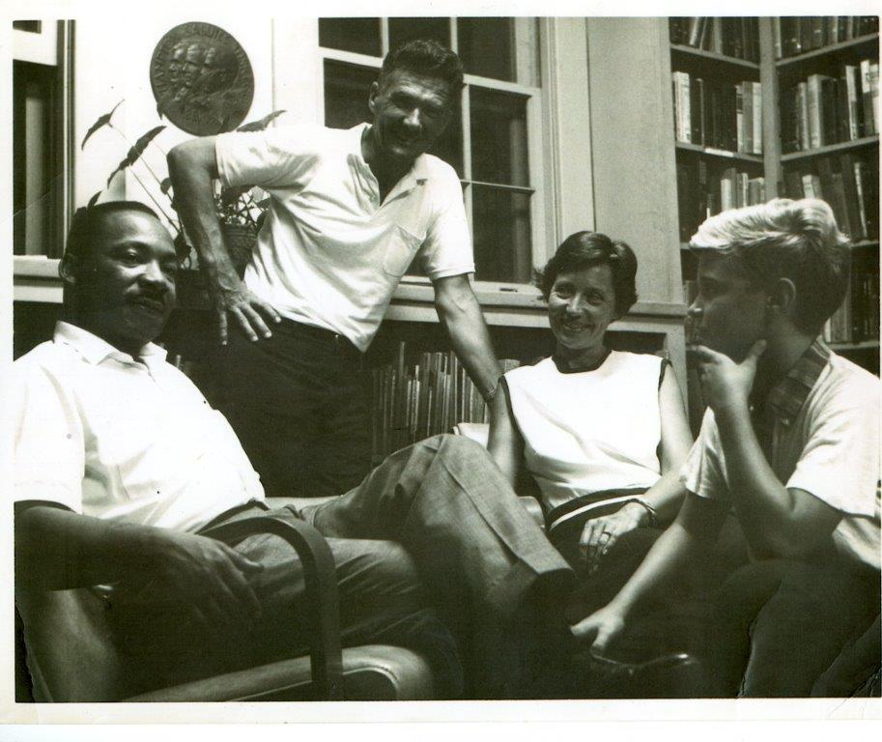
King and Siceloff Family
Notes:
Martin Luther King, Jr. with Siceloff family, Courtney, Elizabeth, and son John

Slide 31
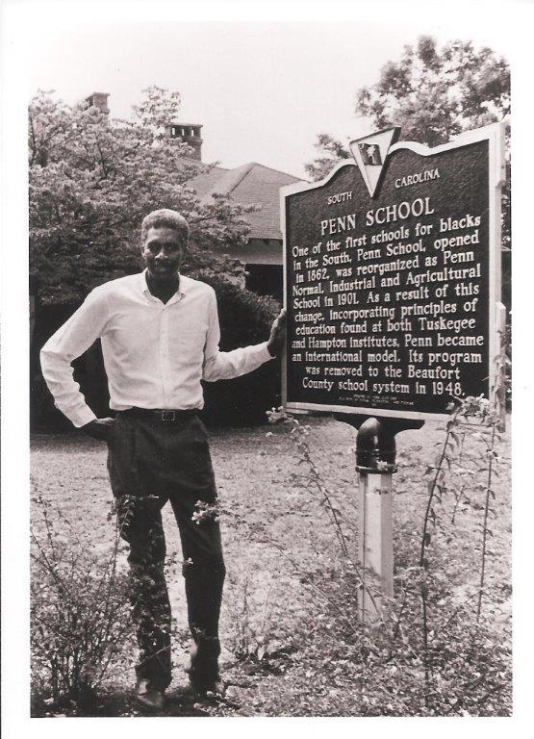
Emory Campbell
Notes:
Emory Campbell, former Director

Slide 32
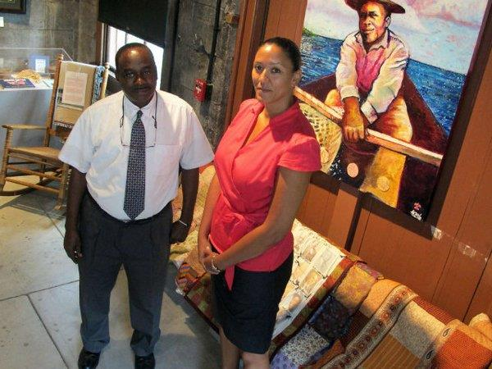
Walter Mack and Victoria Smalls
Notes:
Walter Mack & Victoria Smalls in Museum at Penn Center

Slide 33
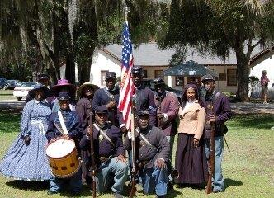
54th Mass Re-enactors
Notes:
54th Massachusetts, re-enactors

Slide 34
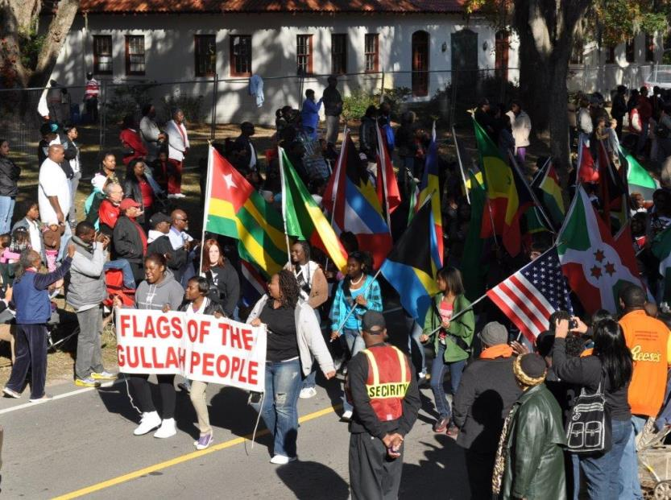
Heritage Day Parade Flags of Gullah People
Notes:
Heritage Days Parade of Flags of the Gullah People

Slide 35
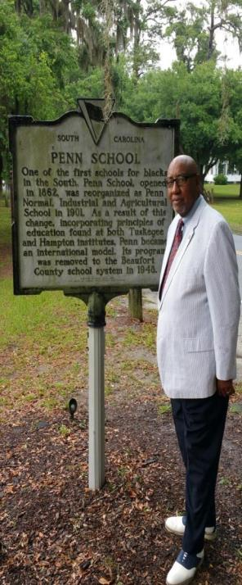
Notes:
Dr. Rodell Lawrence

